Slide 1
Basic Objects and Properties
Application
Renders
Scene
Object List
Current
Object
Lights
Log
Window

Slide 2
Application Properties
// Main Windows Setting
property pWinLeft : integer read objWinLeft write objWinLeft;
property pWinWidth : integer read objWinWidth write objWinWidth;
property pWinTop : integer read objWinTop write objWinTop;
property pWinHeight : integer read objWinHeight write objWinHeight;
// Texture Window
property pTextureWdt : integer read objTextureWdt write objTextureWdt;
// Property Frames
property pSceneOn : boolean read objSceneOn write objSceneOn;
property pListOn : boolean read objListOn write objListOn;
property pListHeigth : integer read objListHeigth write objListHeigth;
property pPropOn : boolean read objPropOn write objPropOn;
property pPropHeight : integer read objPropHeight write objPropHeight;
property pLightsOn : boolean read objLightsOn write objLightsOn;
property pTrackingOn : boolean read objTrackingOn write objTrackingOn;
property pLogOn : boolean read objLogOn write objLogOn;
// Application Hint
property pHintOn : boolean read objHintOn write objHintOn;
// Current Scene
property pSceneName : string read objSceneName write objSceneName;
// Common Document Folder
property pComFolder : string read objComFolder write objComFolder;

Slide 3


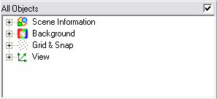
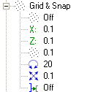

Scene Properties
Scene Name
Scene Common Folder
Application Common Folder
Hints On/Off
Set Scene background Color (Double Click to open Color Dialog)
Fog
Grid Settings:
Show Grid On/Off
Grid X, Y and Z (moving)
Angle Snap To
Scale Snap To
Snap To Object
View Settings:
Perspective On/Off
Show Coordinate System
Speed (0..5x)
Solid / Wireframe

Slide 4
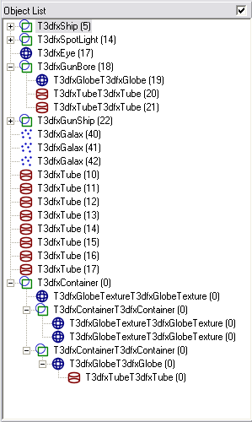
Object List
Each Object has:
  Image (Its Drawing Primitive)
  Class Name
  Unique Id
Each Object:
  Can contain other objects. These objects properties like Scale, Origin, Angles etc. are relative to its parent
A Container is a specialized object that has no own drawing primitive, it can only contain other objects.
Its not visible. Can be viewed when selected by its Bounding Box (Extent).

Slide 5
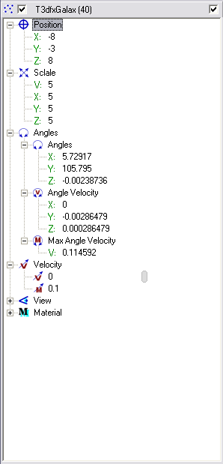
Object Properties
Object Position (Origin)
X, y, and z can be adjusted with slider and Snap to Grid
Object Scale
X, y, and z can be adjusted with slider and Snap to Scale Snap To
V: adjusts x, y, and z proportionally
Object Angle
X, y, and z can be adjusted with slider and Snap to Angle Snap To
DON’T WORK AT THE MOMENT
Object Angle Velocity
X, y, and z can be adjusted with slider and Snap to Angle Snap To
Double Click will set Zero angle velocity
Object Angle Velocity Max
Sets the maximal angle velocity for object
Object Velocity
Sets the velocity in View Look At vector
Object Velocity Max
Sets the maximal velocity for object

Slide 6
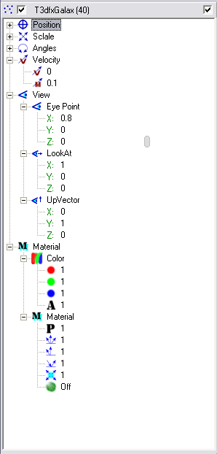
Object Properties
Object View
All objects can act as an Eye
Eye Position of the object
X, y, and z can be adjusted with slider and Snap to Grid
Eye Look At vector of the object
X, y, and z can be adjusted with slider and Snap to Grid
Up vector of the object
X, y, and z can be adjusted with slider and Snap to Grid
Material Color
Red, Green, and Blue can be adjusted with slider and Snap to Grid
A = Alpha does not work
Double Click will open Color Pick dialog
Material Reflection properties
Power
Ambient
Diffusion
Specular
Transparency

Slide 7
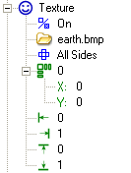
Object Texture
Sets Texture On/off
Browse for a Jpg or Bmp picture file.
Can have any size (256 or 512 is good)
F
Texture Style:
Front
Front & Back
All Sides
F
B
Multiple:
0 = Wrapping is Off
1..N = Wrapping is On
L
F
R
U
B
D
Wrapping Offsets in X and Y.
Only when Multiple > 0
Adjustment of start and end X/Y texture mapping.
Only when Multiple = 0

Slide 8
Main Window Popup Menu
Cube
Board
Rectangle
Tube
Sphere
Arrow
Line
Container
LightBulb
Load as Object
Load as Component
Load Temp
Insert / Load Object
Save Object
Cut Ctrl+X
Copy Ctrl-C
Paste Ctrl+V
Delete Del
View
Edit Plane Object
Save
Save As..
Save as Temp
World
Through Object

